Slide 1
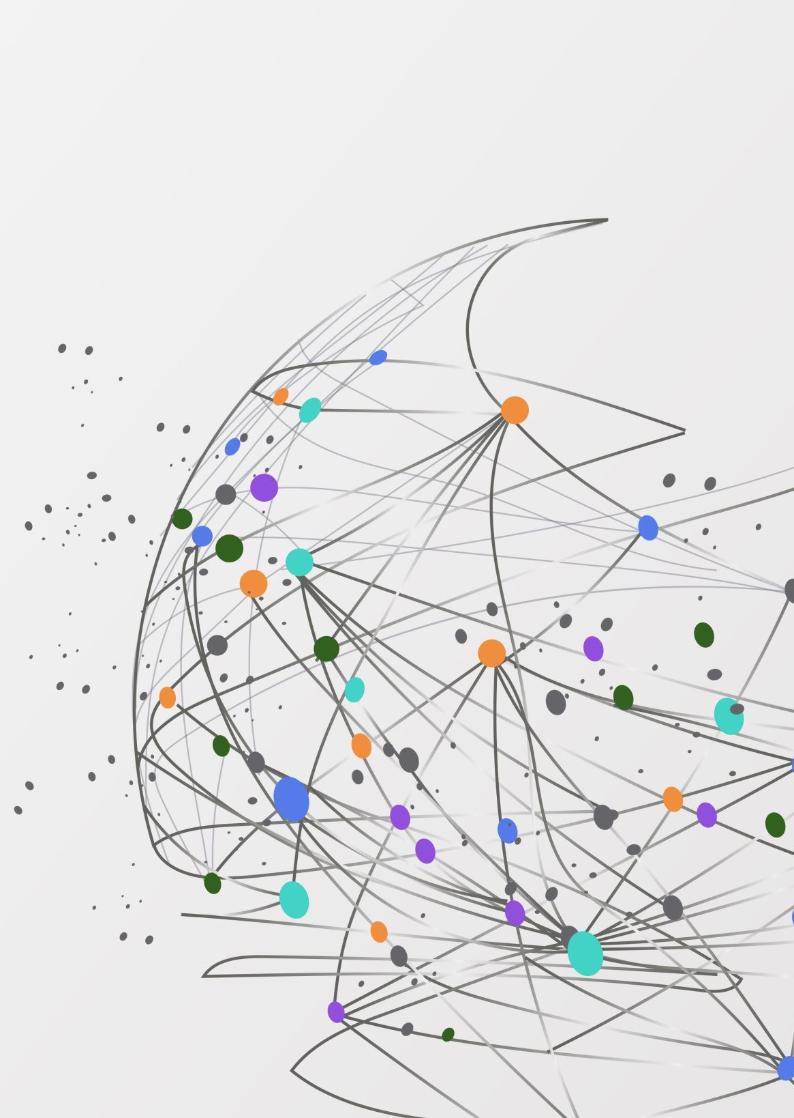
HR Analytics
Prepared By : Mohammed Rumaan Nawaz
Date : 2/2/2025

Slide 2

Objective
The objective of this project is to develop an HR Analytics Dashboard that provides comprehensive insights into employee data, aiding in strategic decision-making. The dashboard aims to:
Analyze workforce demographics to identify diversity gaps.
Monitor attrition trends to enhance employee retention strategies.
Assess job satisfaction levels to improve workplace engagement.
Evaluate employee performance for targeted training and development.
Track salary distribution to ensure fair compensation practices.
Identify absenteeism patterns to address potential work culture issues.

Slide 3

Introduction
The HR Analytics Dashboard serves as a crucial tool for analyzing key human resource metrics, enabling data-driven decision-making. This report provides a comprehensive review of the dashboard, assessing its design, usability, data visualization, and overall effectiveness in delivering actionable insights.

Slide 4

Design & Layout
The dashboard follows a clean and structured layout, ensuring clarity and ease of navigation.
A consistent color scheme and font selection enhance readability and visual appeal.
Elements are well-aligned and spaced appropriately, preventing clutter.
Recommendation: Consider incorporating company branding, such as a logo and theme colors, to enhance professionalism.

Slide 5

Data Visualization
The use of bar charts, pie charts, and KPI indicators effectively presents HR metrics.
Visual elements are clear and appropriately labeled, making the data easy to interpret.
Color contrast is generally effective, but pie chart segments could be more distinguishable.
Recommendation: Introduce interactive features such as tooltips, drill-through options, and slicers for enhanced data exploration.

Slide 6

Usability & Navigation
Labels and headings are clear and intuitive, allowing for quick comprehension of metrics.
The dashboard design promotes easy navigation and user engagement.
Recommendation: If multiple pages exist, add navigation buttons or a menu for seamless transitions. A data glossary could also be included to clarify specific HR terms.

Slide 7

Key Metrics & Insights
5.1 Employee Demographics (Pie Chart)
Displays employee distribution by department, gender, or age group.
Key Insight: If any category dominates, it indicates an imbalance that HR might address (e.g., diversity initiatives).
5.2 Attrition Rate (Graph)
Showcases employee turnover trends over time.
Key Insight: If attrition is high in certain months or departments, HR should investigate reasons like job dissatisfaction, workload, or management issues.

Slide 8

5.3 Job Satisfaction (Table)
Categorizes employees by job satisfaction scores (e.g., low, medium, high).
Key Insight: If a significant percentage reports low satisfaction, HR may need to implement engagement strategies, better compensation, or work-life balance improvements.
5.4 Employee Performance Metrics
Highlights average performance ratings across departments.
Key Insight: If certain teams underperform, targeted training or leadership interventions may be required.

Slide 9

5.5 Salary Distribution & Benefits
Displays salary ranges per role or department.
Key Insight: Disparities in pay might indicate the need for salary adjustments or competitive benchmarking.
5.6 Attendance & Leave Patterns
Depicts absenteeism trends over time.
Key Insight: Frequent leaves in specific months or teams may signal burnout, poor work culture, or operational inefficiencies.

Slide 10

Conclusion
The HR Analytics Dashboard is well-structured, visually appealing, and informative, effectively conveying HR-related insights. Implementing the recommended improvements will enhance its usability, interactivity, and overall impact in facilitating data-driven HR decision-making.

